Slide 1
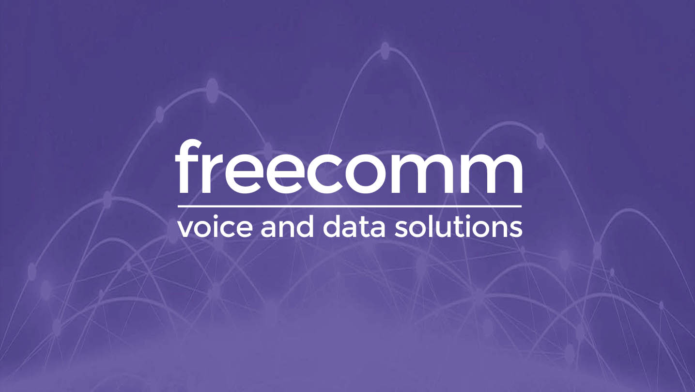

Slide 2

Freecomm Contact Centre

Slide 3

Why add omni-channel features?
Call Centre operations need to deliver the right features for market trends
Small to Medium sized customer requirements are growing, but they need the enterprise scale solutions at an affordable cost
Contact centres can’t deliver a unified solution, they only deliver the voice contact centre – Splitting them from the rest of the organisation
Enable the customer to grow and expand their requirements as they need to
They need expanding roadmap of features with the ability to scale up or down

Slide 4
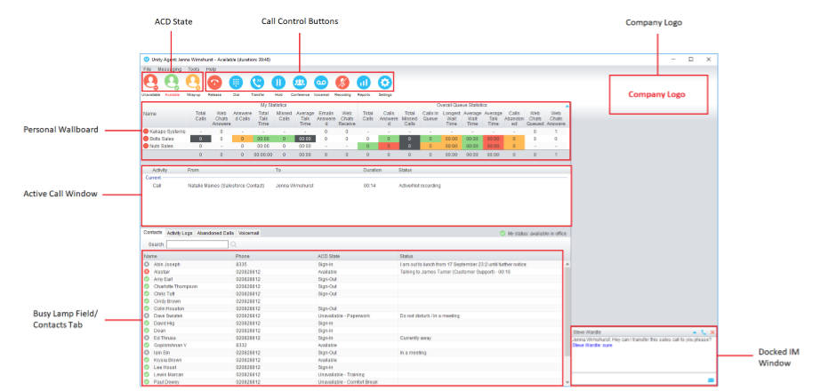
Client application for client users
ACD, Call Control, Sign in out, Recording/Pause/Resume
Team and personal stats – Channel reporting
Direct Dial and Calling Line Presentation Control
Chat
Channels
  Twitter
  Email
  Chat
  Call Back
  Audio

Slide 5
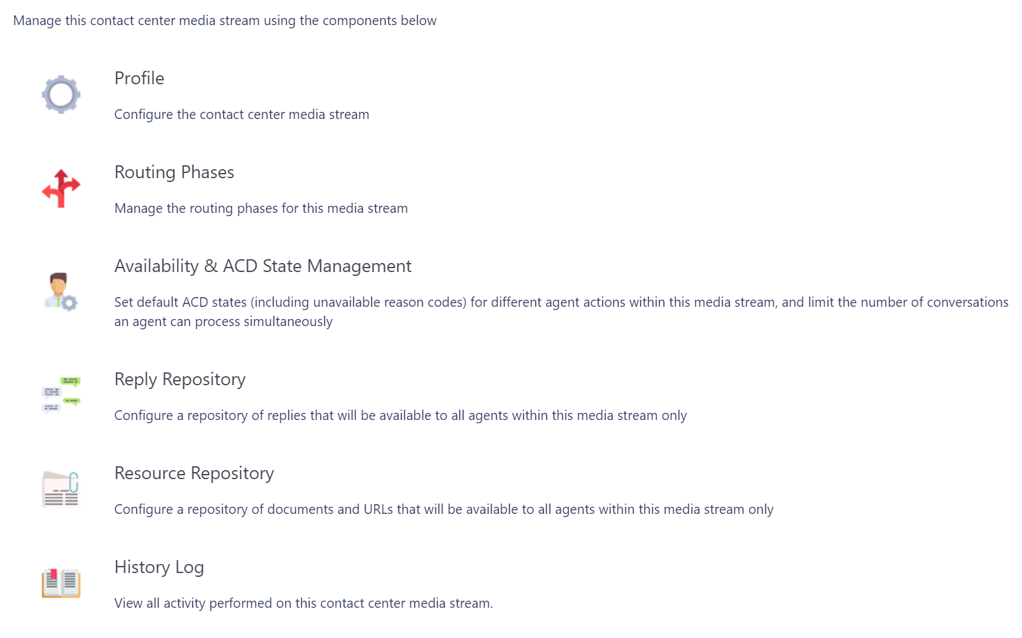
Omni channel Management
Full configured call centre
Customer Branding
Manage number of interactions per channel per agent
Control routing between agents
Customer configurable tools to control your call centre
Notes:
Not sure if I like this slide…

Slide 6
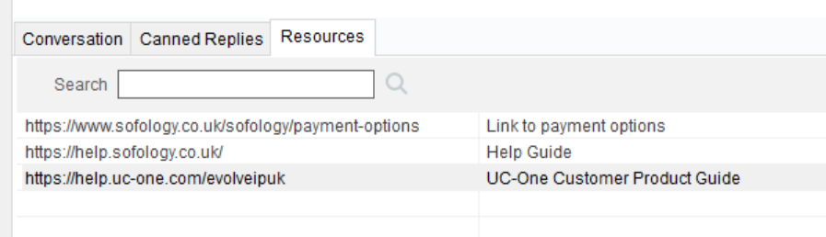
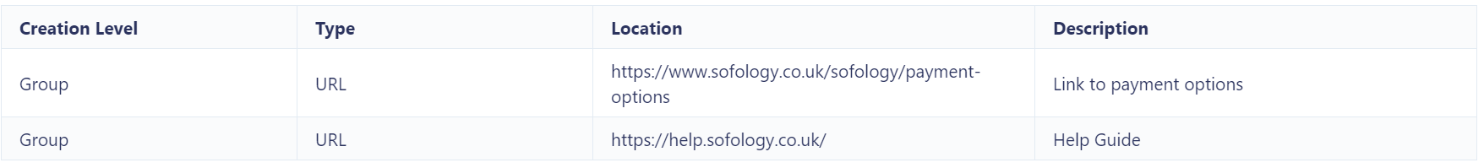
Channel benefits
Custom Reply Repository
Standardise and simplify agent activity
Customer managed replies
Rapid replies with correct information
Know who has actioned and is actioning communication
Deliver demonstrable improvement to any call centre
Notes:
Not sure if I like this slide…

Slide 7
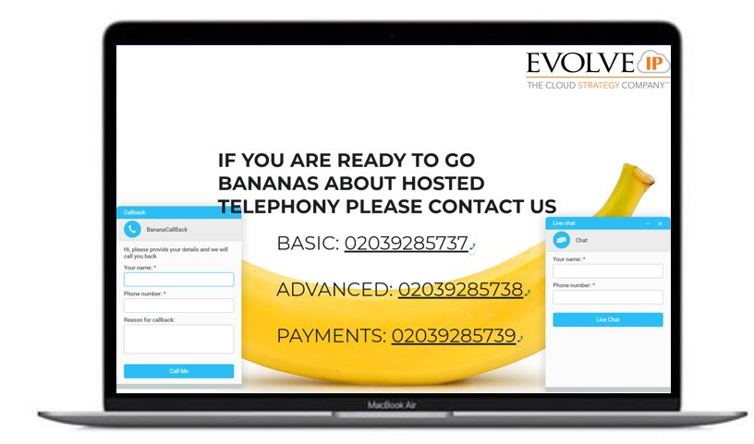
Website plug-ins
Chat Bot (on line chat conversation)
Call Back
  Scheduled call back*
  Reason for Call*
Simple to add
Brand with customer images
Configurable auto-responses
* coming soon
Notes:
Too blurry?

Slide 8
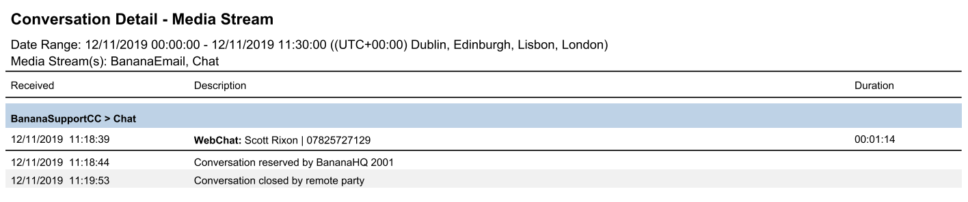
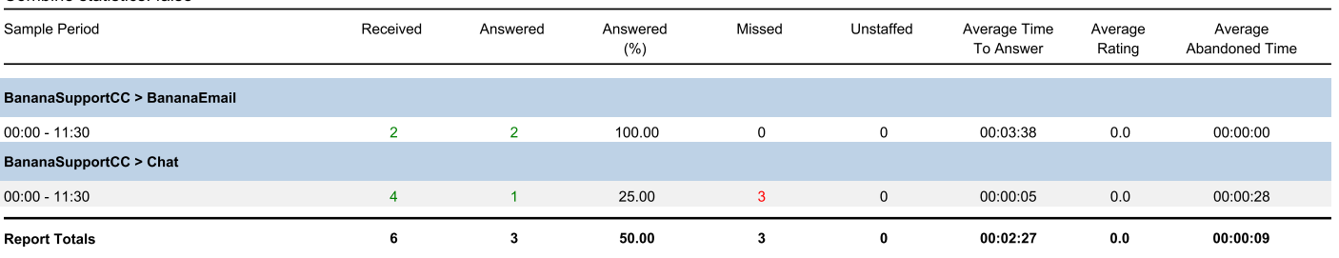
Omni channel history
Easily see chat history
  See exactly what agents said to customer
Reporting of actions – Drill down PDF to detail
Performance reporting and KPI of channels
Notes:
Not sure if I like this slide…

Slide 9
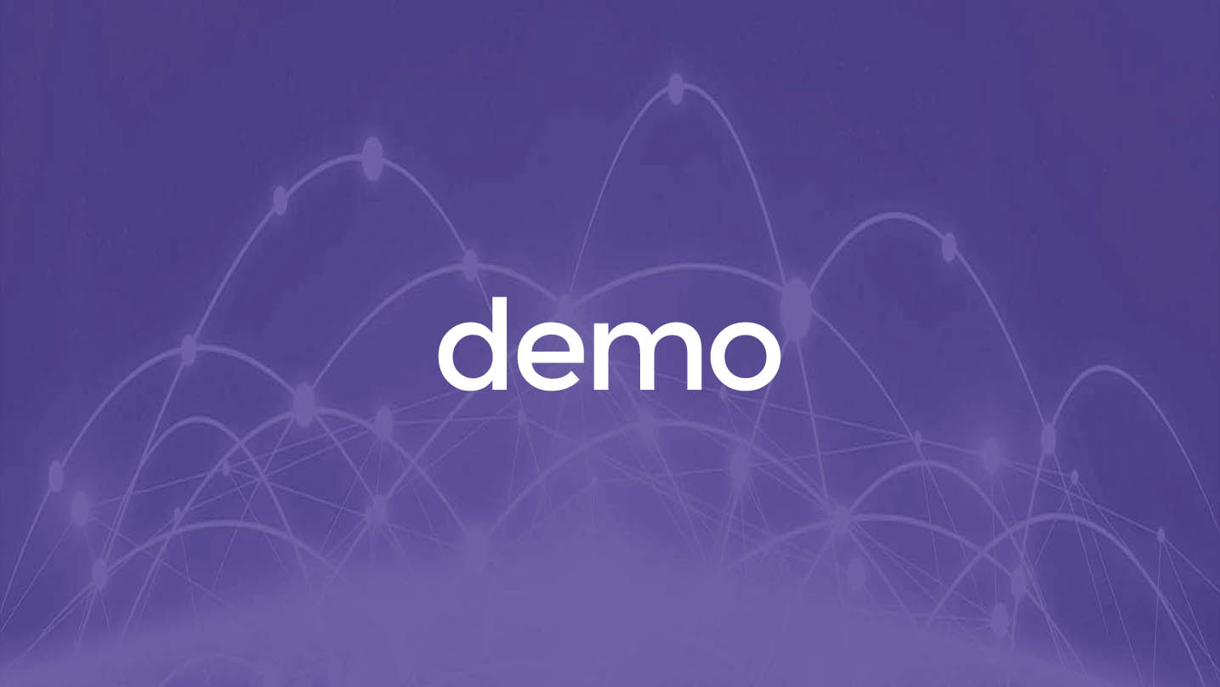

Slide 10
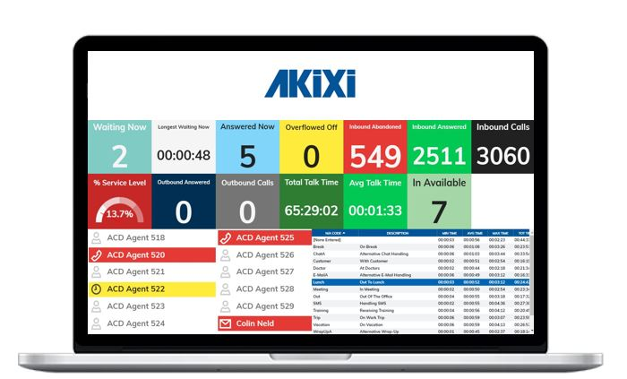
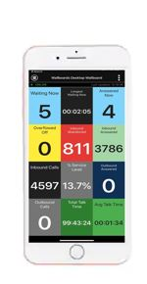
Akixi call analytics
Key points​
Real time​
ACD agent control​
Include in our omni-channel CC licenses​
Mobile app​
Akixi & Dubber integration
Flexibility to filter and dissect your data
Automated reports
Akixi & Dubber Integration
Notes:
Feels like it needs something else….

Slide 11
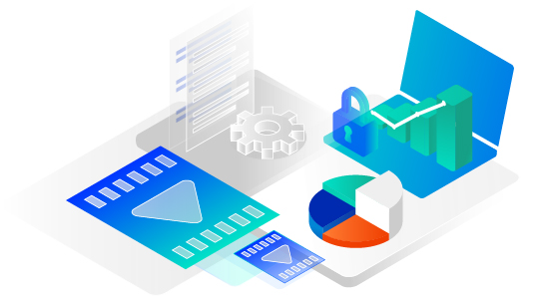
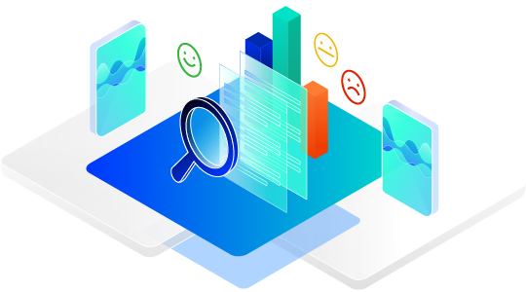
Dubber call recording
Key Facts:
60 Day, 1 Year, 5 Year or 7 Year Unlimited Storage
Encrypted in AWS UK Data Centres, or US on request
Open API
GDPR, MiFID II Compliant
PCI Compliant - Pause & Resume Recordings
AI Enhancements:
Transcription
Sentiment
Key Word
Data Export to BI solutions

Slide 12

Intelligent virtual agents
Intelligent Virtual Agents
  FAQ
  Answer questions
  Reservations
  Call Updates
  Key Information
  Chat Bot
  Payments
  Call Routing
  API Integration
Technology to drive customer service and lower agent touch time

Slide 13

CALLBAck / Q For me
Q for Me (Virtual Queuing)
  Hold your place in the queue
  Call back when agent available
Notes:
You may want to add a few more points...

Slide 14

Where are we going
Reporting API – Connect our audio reporting to your data warehouse
Disposition codes in wrap up – Mark the type of call and enable reporting
AI from call recording – Transcribe your call recording and start to create insights
Deliver contact centre data into 3rd party work force management solutions
Facebook and SMS integration to desktop client

Slide 15

What else might they want?
SMS Automation with an IVA
Outbound Dialler functionality
Integration with Dubber AI data

Slide 16
License packs
UC Contact – Standard Audio Only
UC Contact – Standard Omni
UC Contact – Premium Audio Only
UC Contact – Premium Omni
All have call centre licence
All have unity client licence
All have Akixi 2000 reporting
Add a UC licence, media channels, Inteligent Agents and call recording to fit your customer

Slide 17


Who is Interested
Current call centres Any Customer no matter how small
Customers wishing to enhance productivity
Customers who want to raise there business profile
Live report on actions taken
Customer demographic changing
Customers using 3rd party chat and email
Integrate all channels of communication
Expand current call centre skills
Easy Transition

Slide 18
